Slide 1

DSO 552 Fall 2021
Class 4 SQL - Joining Tables
By Arsames Qajar qajar@usc.edu

Slide 2
Outline
Please create a new database and call it northwind if you didnt do so last week
Upload this dataset to the northwind database
Review this guide for help setting up the database & uploading data
Continue DML, start Aggregate functions and JOINs
Filtering with the WHERE clause
Logical and Comparison operators
LIKE pattern matching
Aggregate functions (COUNT, AVG, etc) with GROUP BY statement
JOINS (e.g. INNER, LEFT join) for merging tables together (primary keys to foreign keys)

Slide 3
Continuing WHERE & Operators

Slide 4
SELECT statement (DML)
SELECT [ specify columnlist by name or calculated/created columns ]
FROM [ table_list ]
WHERE [ conditional expression ]
GROUP BY [ group by columnlist ]
HAVING [ filter expression on grouped results i.e. WHERE clause on group]
ORDER BY [ columnlist ASC/DESC ]
LIMIT [ # of rows to be returned ]
Notes:
DDL – Data Definition Language DQl – Data Query Language DML – Data Manipulation Language DCL – Data Control Language

Slide 5
Distinct & Distinct On
Limiting number of results not to overload database
SELECT columns… FROM table LIMIT # of records needed
DISTINCT keyword must be applied to remove duplicates in results and/or show unique combinations
DISTINCT ON returns the first row from the set of duplicate rows
Example
SELECT distinct column1
FROM table_name
vs
SELECT distinct column1, column2
FROM table_name
Unique combinations of column1 and column2
SELECT
DISTINCT ON (column1 or expression) column1, columnlist...
FROM table_name

Slide 6
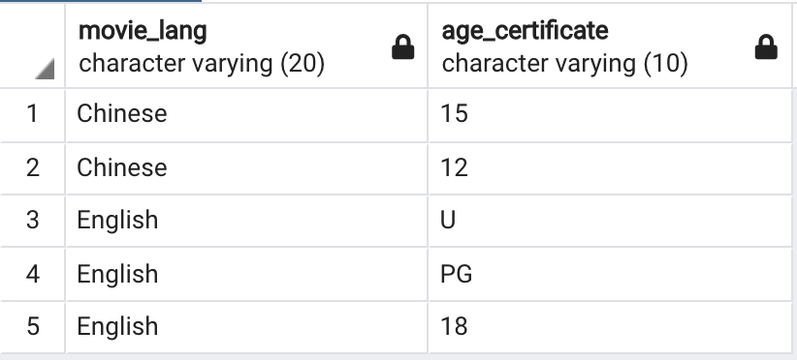
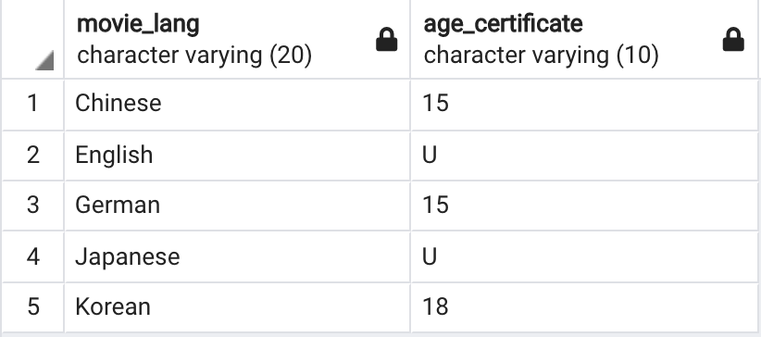
Distinct & Distinct On
Also see here
** See in Class Problems 7-10 **
select distinct movie_lang, age_certificate
from movies
order by movie_lang, age_certificate desc
limit 5;
select distinct on (movie_lang) movie_lang, age_certificate
from movies
order by movie_lang, age_certificate desc
limit 5;

Slide 7
WHERE clause (DML)
Syntax:
SELECT select_list
FROM table_name
WHERE filter_condition
ORDER BY sort_expression
Column conditions that filter/specify which rows should be returned
The conditions in the WHERE clause use operators: comparison, arithmetic, logical operators
Column aliases in the SELECT clause cannot be used in the WHERE clause

Slide 8
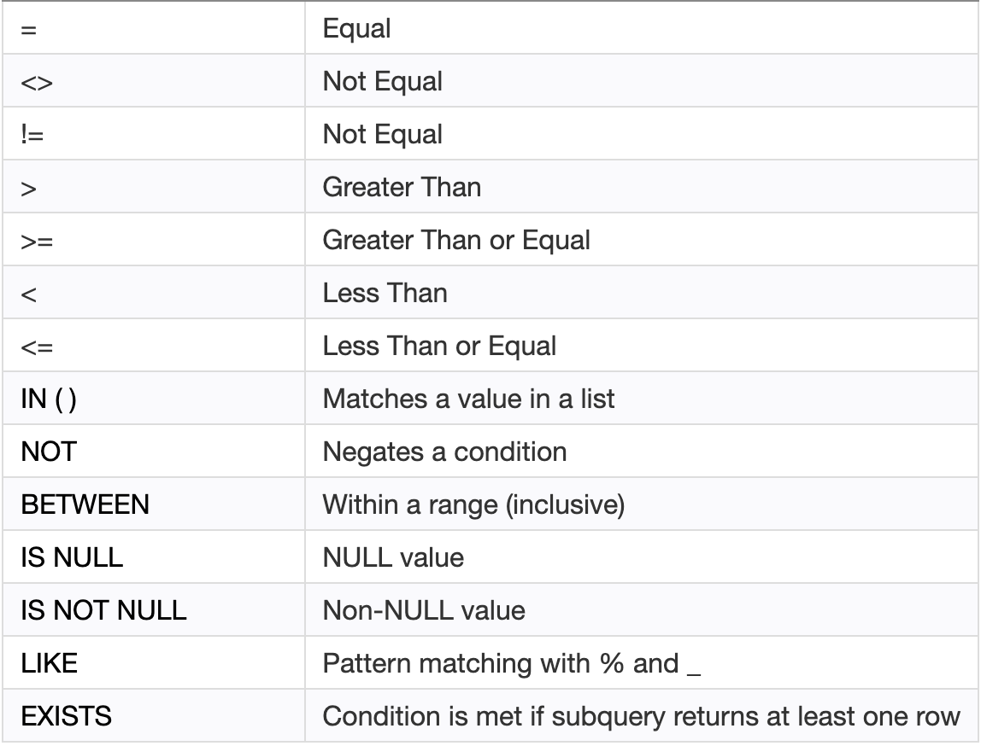
Comparison & Logical Operators
For more info, see Comparison Op. in ch. 5 here & Logical in Ch. 6 here
Logical/Boolean Operators: used to combine one or more conditions using any one of the following: AND, OR, NOT
AND = if both boolean expressions are true then it will return true
OR = if any boolean expression is true then it will return true
NOT = Reverses the value of Boolean operator
*Note* by default, the AND operator takes precedence over the OR operator. See example below:
SELECT *
FROM
Table
WHERE
col1 > value1 OR
col2>value2 AND col3>value3
Comparison Operators: Compare a column value to another column
value or value of the same datatype
WHERE
col1 > value1 OR
( col2 > value2 AND col3 > value3 )
Notes:
https://www.techonthenet.com/postgresql/comparison_operators.php

Slide 9
Comparison & Logical Operators
For more on operators & expressions see here. Below using movies database.
SELECT *
FROM movies
WHERE movie_length BETWEEN 50 AND 120
SELECT *
FROM movies
WHERE
movie_length > 100 or
movie_lang <> 'English'
AND age_certificate <> '18'
ORDER BY
movie_name, movie_length
LIMIT 1;
SELECT *
FROM movies
WHERE movie_length >=50 AND
movie_length<=120
is equivalent to
Best Practice Use parenthesis () to ensure the intended order of precedence
AND evaluated first i.e. movie_length >100 OR (movie_lang > 100… )
SELECT *
FROM movies
WHERE
(movie_length > 100 or
movie_lang <> 'English' )
AND age_certificate <> '18'
ORDER BY
movie_name, movie_length
LIMIT 1;
Note: These two queries yield very different results

Slide 10
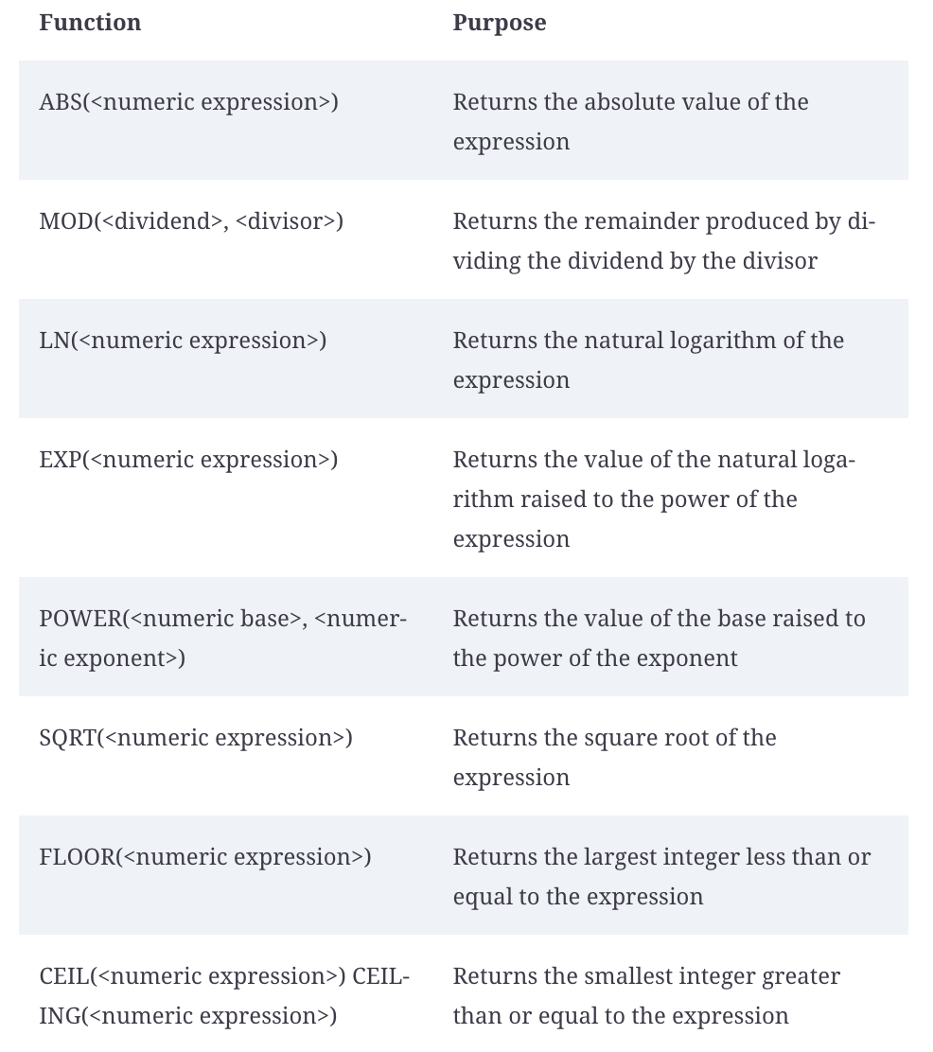
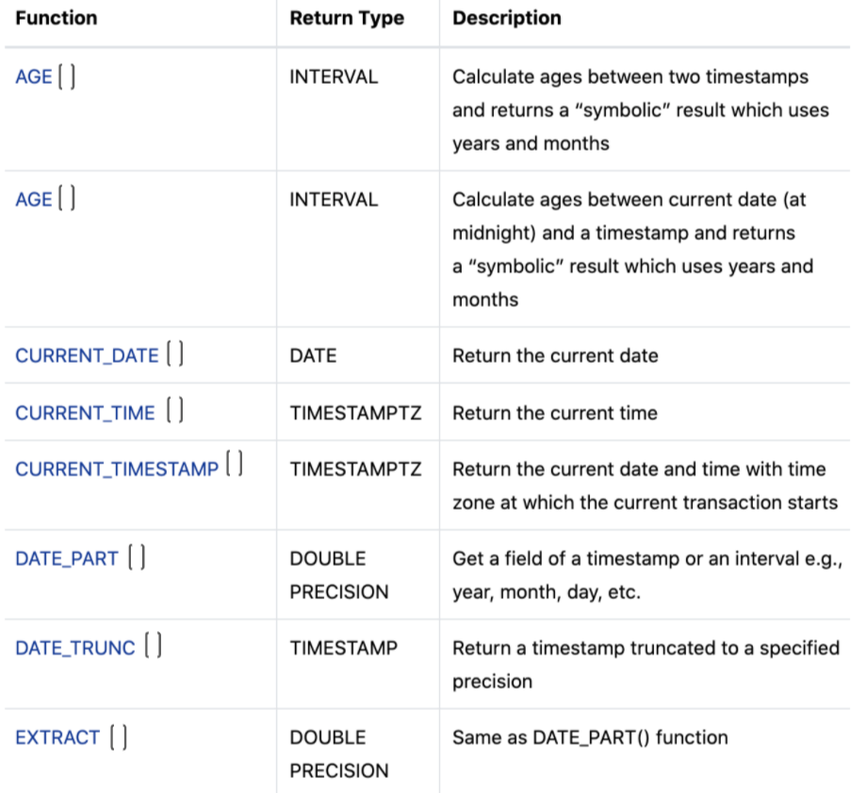
Other Operators & Expressions
Common Math and Date operators
See more Math operators here
See Date operators here

Slide 11
Pattern Matching
LIKE keyword to match a pattern Syntax: WHERE value LIKE ‘pattern’
Percent sign ( %) matches any sequence of zero or more characters
‘%a’ matches any string, regardless of length, that ends with `a`
‘a%’ matches any string, regardless of length, that starts with `a`
Underscore sign ( _) matches any single character.
‘_a_’ matches any three character string where ‘a’ is the second character
Matches are case-sensitive
Example
SELECT
'foo' LIKE 'f%', is true because
'foo' LIKE '_o_', is true
'bar' LIKE 'b_'; is false because bar has 3 letter and the pattern is only 2 letters

Slide 12
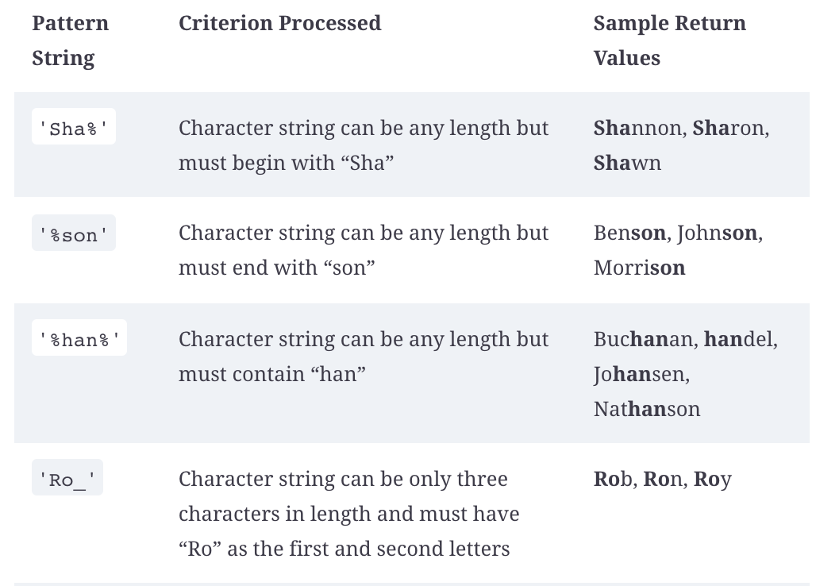
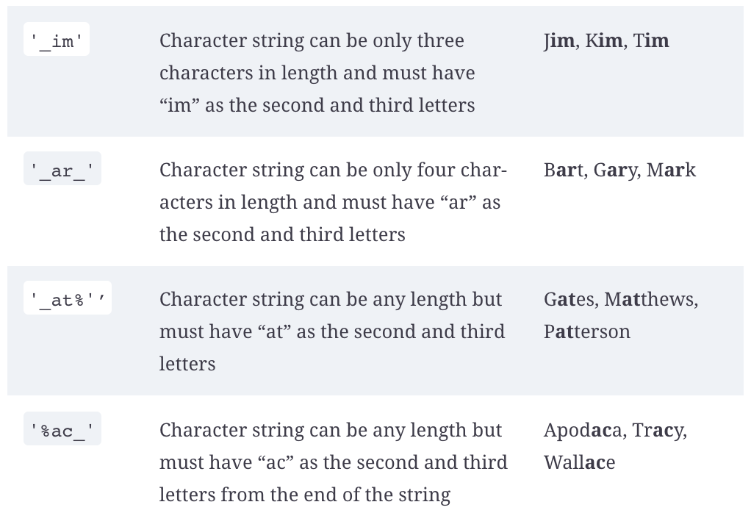
Pattern Matching
For more info see Ch. 6 here

Slide 13
WHERE clause
Sample problems using Northwind database
** Use the northwind database **
select
contact_name, contact_title, company_name,
LENGTH(company_name) cname_length,
country
from
suppliers
where
contact_title NOT LIKE '%Manager%' OR
country IN ('Canada', 'Denmark') AND
LENGTH(company_name) BETWEEN 9 AND 18
order by
cname_length desc,
contact_name,
country
limit 2;
NOT LIKE find ‘Manager’ anywhere in contact_title field. NOT can also be placed before the column/attribute contact_title and yield the same results
AND clause takes precedence over the OR. Can also be re-written as:
contact_title NOT LIKE '%Manager%' OR
(country IN ('Canada', 'Denmark') AND
LENGTH(company_name) BETWEEN 9 AND 18)
LENGTH() of any company_name string is between 9 and 18. Note alias can not be used in where clause

Slide 14
Aggregate Expressions & Group By MIN, MAX, SUM, COUNT, etc with GROUP BY for itemized/grouped data

Slide 15
Aggregate Functions with Group By
Grouping and summarizing data & other functions here
Most common aggregate expressions for summarizing data: COUNT(), MAX(), MIN(), AVG(), SUM()
Can execute such functions on a table with respect to a filter e.g.
SELECT count(*) FROM table → returns the number of rows in the table
SELECT max(expression) FROM table → returns the maximum value in a set, string or numeric
GROUP BY keyword is used to separate the data returned from a SELECT statement into any number of groups given the column(s) provided to it
Can be accompanied by a HAVING clause → essentially a WHERE statements performed on the group(s) e.g. HAVING count(*) > value
Group By Syntax:
SELECT
column_1,
column_2,
...,
aggregate_function(column_3)
FROM table_name
GROUP BY
column_1,
column_2, …;
These columns become the GROUP BY group selection criteria
Aggregate function such as count() gets computed given the un-aggregated columns
GROUP BY must contain the non-aggregated columns

Slide 16
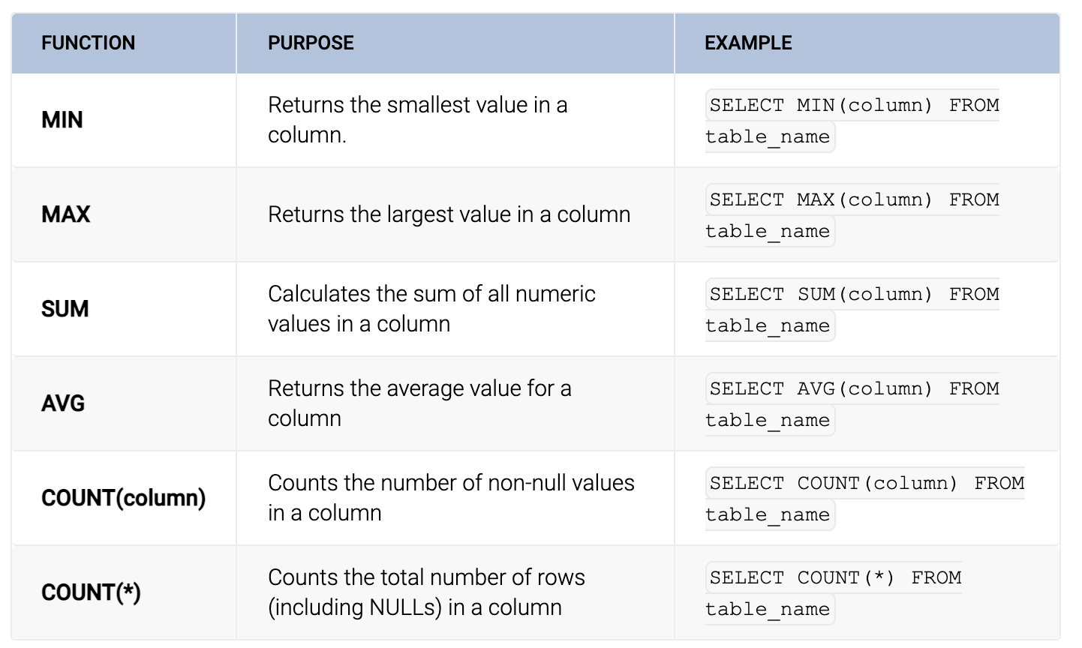
Aggregate Functions with Group By
Grouping and summarizing data & other functions here

Slide 17
Group By
Group By example
Question:
From the orders table, find the count of orders as number_of_orders and the maximum freight as m_freight grouped by employee_id. Rows are filtered out of the results if the maximum freight of a group is less than 800 or the shipped_date of an order IS NULL. Sort by the maximum freight size descending.
What are the aggregate functions being used?
Does this query require a HAVING and WHERE clause or just one of them ?

Slide 18
Group By
Group By example
Question:
From the orders table, find the count of orders as number_of_orders and the maximum freight as m_freight grouped by employee_id. Rows are filtered out of the results if the maximum freight of a group is less than 800 or the shipped_date of an order IS NULL. Sort by the maximum freight size descending.
SELECT employee_id,
COUNT(*) number_of_orders,
MAX(freight) m_freight
FROM orders
WHERE
shipped_date IS NOT NULL
GROUP BY 1
HAVING
MAX(freight) >= 800
ORDER BY
3 desc

Slide 19
Group By
Examples & more here
** Use the northwind database **
SELECT employee_id,
COUNT(*) number_of_orders,
MAX(freight) max_freight
FROM orders
WHERE
shipped_date IS NOT NULL
GROUP BY 1
HAVING
MAX(freight) >= 800
ORDER BY
3 desc
employee_id must be one of the parameters in the grouping criteria
count() and max() are computed as a result of the distinct groupings
GROUP BY 1 refers to the column in the first position of the SELECT statement i.e. employee_id
HAVING clause does not have access to the alias created in the SELECT statement

Slide 20
Group By
WHERE vs HAVING clause
SELECT employee_id,
COUNT(*) number_of_orders,
MAX(freight) max_freight
FROM Orders
WHERE
shipped_date IS NOT NULL
GROUP BY 1
HAVING
MAX(freight) >= 800
ORDER BY
3 desc
When to use WHERE vs HAVING clause:
WHERE
Applies only on individual rows
Can not use aggregate functions
No access to alias used by column
WHERE clause ensures that the shipped_date field is not blank
HAVING
Applies on results of the GROUP BY
Can use aggregate function to filter out results
No access to alias used by column
HAVING clause ensures that the maximum value of the freight field is at least 800

Slide 21
Case Statement
Group By example
SELECT <column_list>,
CASE
WHEN condition1 THEN result1
WHEN condition2 THEN result2
WHEN conditionX THEN resultX
ELSE result
END <alias>;
FROM <table>
Case statements
CASE expression evaluates each row against each WHEN condition, one by one, from the top to bottom until it finds a condition that evaluates to true
If no matches are found or conditions found to be true, then the CASE expression return the ELSE result
Can provide an alias to the case statement to refer to it for later use in other clauses

Slide 22
Case Statement
Example problem
Suppose you want to label the films by their length, call it duration, based on the following logic:
If the movie_length is less than or equal to 90 minutes, the film is “short”
If the length is greater than 90 minutes and less than or equal to 120 minutes, the film is “medium”
If the length is greater than 120 minutes, the film is “long”
Then group by duration and return the count of movies as total, the average movie_length as avg_duration, and the count of distinct movie_lang as languages. Sort by duration ascending.

Slide 23
Aggregate Functions & Group By as Filters
Aggregate functions (MIN, MAX, SUM, etc) along with GROUP BY can be used in the WHERE clause
For example, let’s examine this question:
Return the product_name fields of two products with a
unit_price that are greater than or equal to the average unit_price of the products table

Slide 24
Aggregate Functions & Group By as Filters
Q: Return the product_name fields of two products with a unit_price that are greater than or equal to the average unit_price of the products table
average unit_price of the products table =>
SELECT avg(unit_price)
FROM products

Slide 25
Aggregate Functions & Group By as Filters
Q: Return the product_name fields of two products with a unit_price that are greater than or equal to the average unit_price of the products table
Return the product_name fields
of two products with a unit_price
that are greater than or equal to
SELECT product_name
FROM products
WHERE unit_price >= ( avg_price i.e. slide 24)
=>

Slide 26
Aggregate Functions & Group By as Filters
Q: Return the product_name fields of two products with a unit_price that are greater than or equal to the average unit_price of the products table
SELECT product_name
FROM products
WHERE unit_price >=
( SELECT avg(unit_price)
FROM products )

Slide 27
JOINS - Merging Tables Merging/joining multiple tables

Slide 28
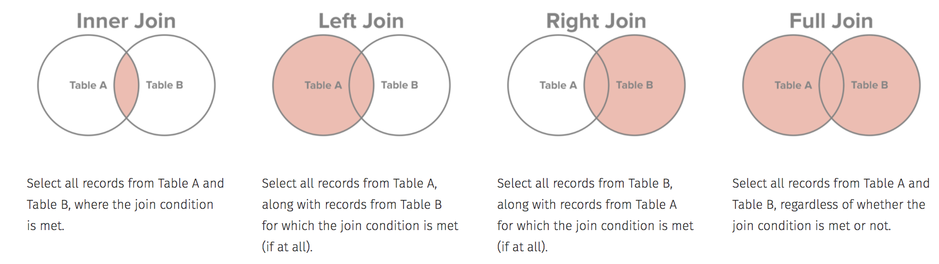
JOINS - Merging Tables
Brings data together from multiple tables
Types of joins: inner, left, right, full
Must specify column in join or assumes primary/foreign key in table

Slide 29
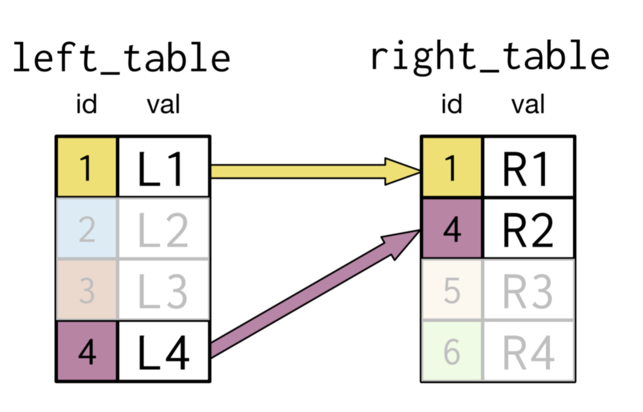
JOINS - Merging Tables
Closer look at an INNER JOIN

Slide 30
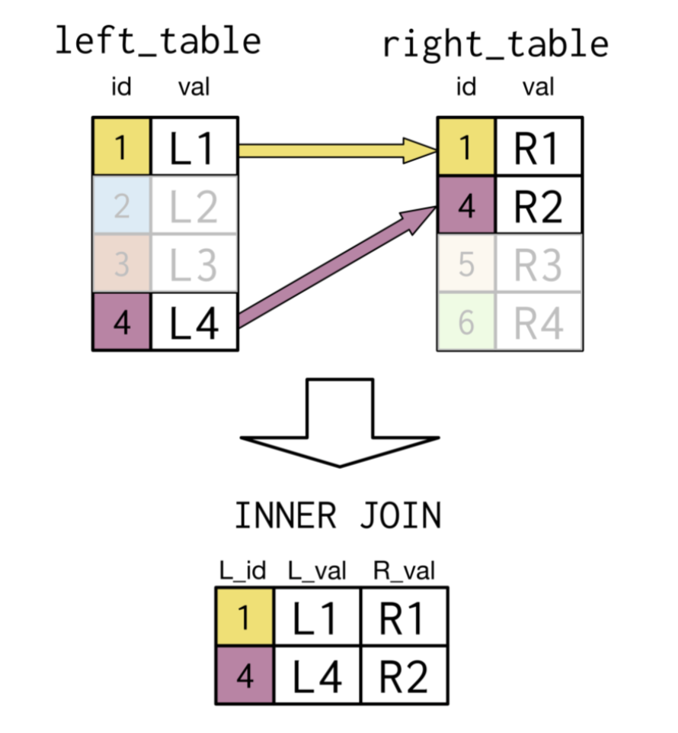
JOINS - Merging Tables
Closer look at an INNER JOIN

Slide 31
Resources &
References

Slide 32
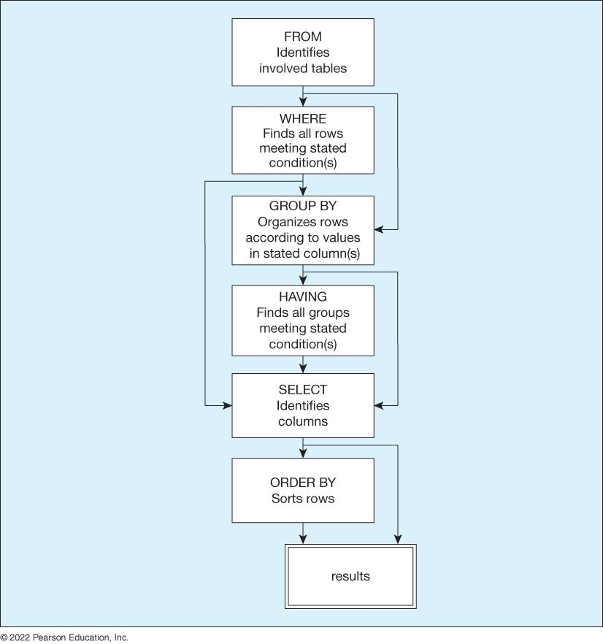
SQL How SQL processes your query
Notes:
https://www.czobel.bit.vt.edu/bit4514/handouts/lecture%2001.pdf p.4
Database vs excel https://365datascience.com/tutorials/sql-tutorials/database-vs-spreadsheet/
https://courses.cs.duke.edu//fall12/compsci316/lectures/01-intro-notes.pdf

Slide 33
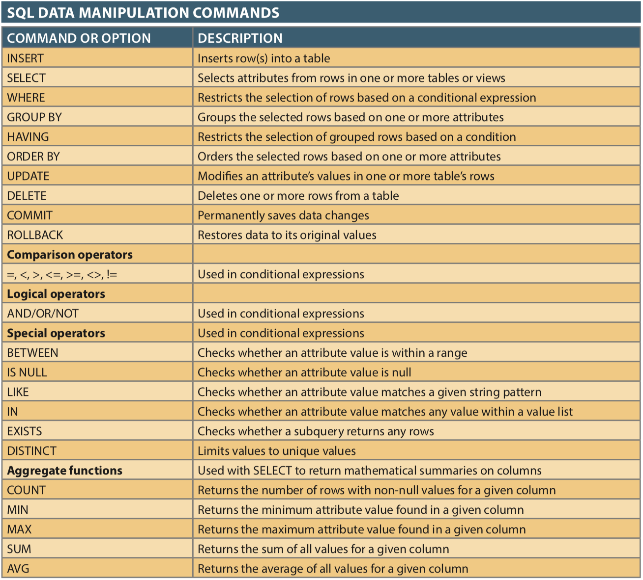
SQL Basics

Slide 34
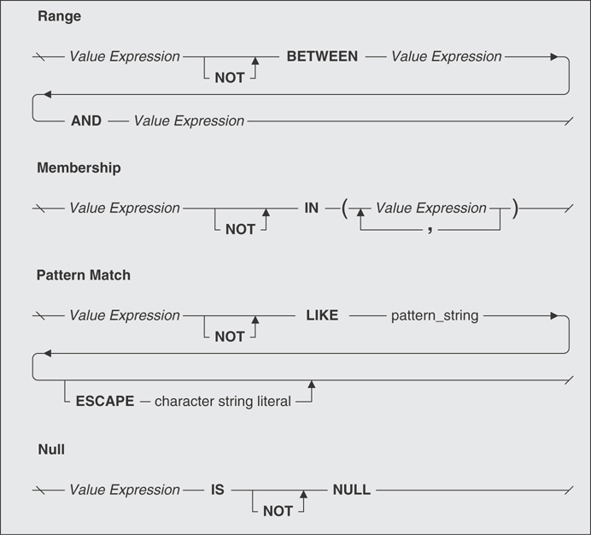
Logical Operator - NOT

Slide 35
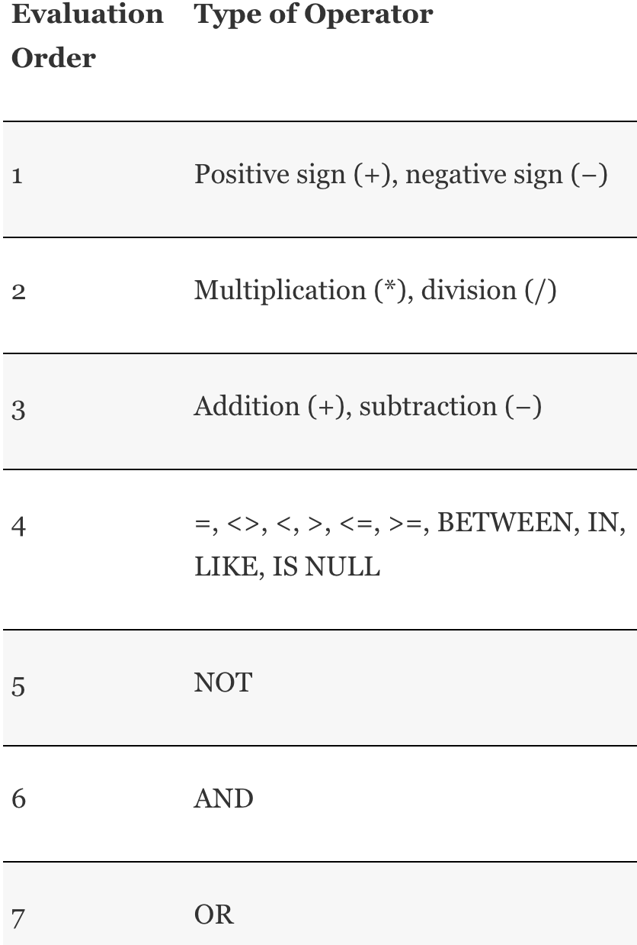
Orders of Precedence

Slide 36
Links/Resources
Postgresql create table
Copy data from file
Data Types & explanations:
Data types documentation, and this and this
Numeric data types here
Tables & data types review (AWS)
PRIMARY KEY constraint
Table & column constraints
Create Table
Alter Table
Psql shell commands

